Slide 1
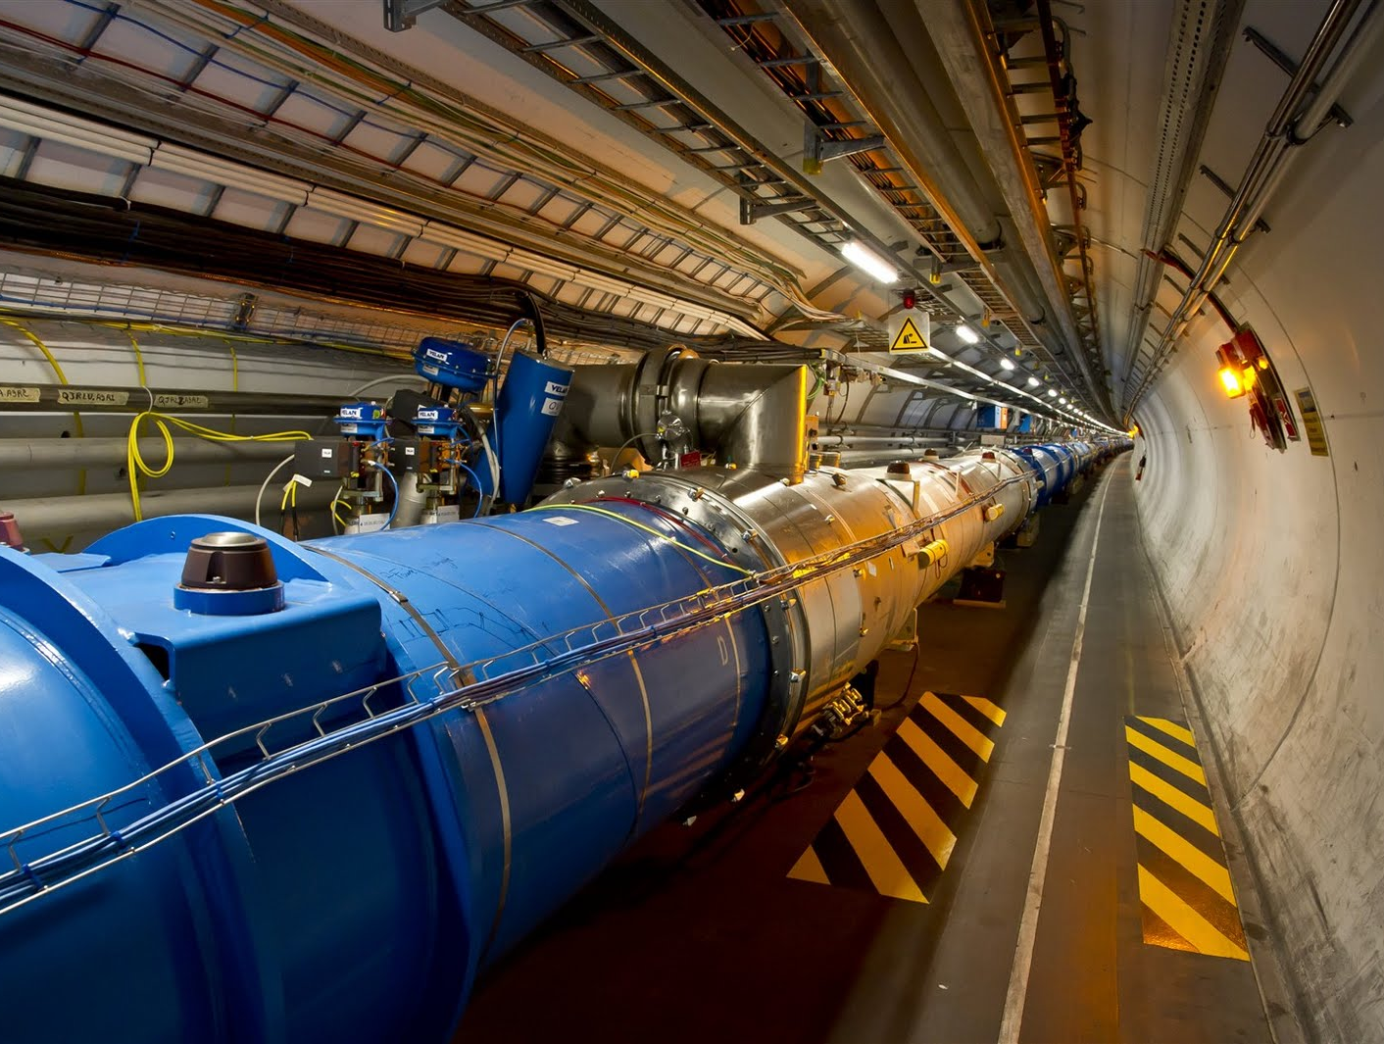


Università degli Studi di Napoli Federico II
European Organization for Nuclear Research (CERN)
Electron cloud studies for CERN particle accelerators and simulation code development
Doctoral thesis by: Giovanni Iadarola
Tutors: Giovanni Miano, Giovanni Rumolo
Napoli, 23 May 2014

Slide 2
Outline
Introduction
The Large Hadron Collider (LHC)
Electron Cloud effects
PyECLOUD: a new code for e-cloud buildup simulation
MacroParticle size management
Performances
E-cloud experimental studies at the LHC
Motivation
e-cloud effects with 25 ns beams at the LHC
Studies for a dedicated scrubbing beam

Slide 3
Outline
Introduction
The Large Hadron Collider (LHC)
Electron Cloud effects
PyECLOUD: a new code for e-cloud buildup simulation
MacroParticle size management
Performances
E-cloud experimental studies at the LHC
Motivation
e-cloud effects with 25 ns beams at the LHC
Studies for a dedicated scrubbing beam

Slide 4
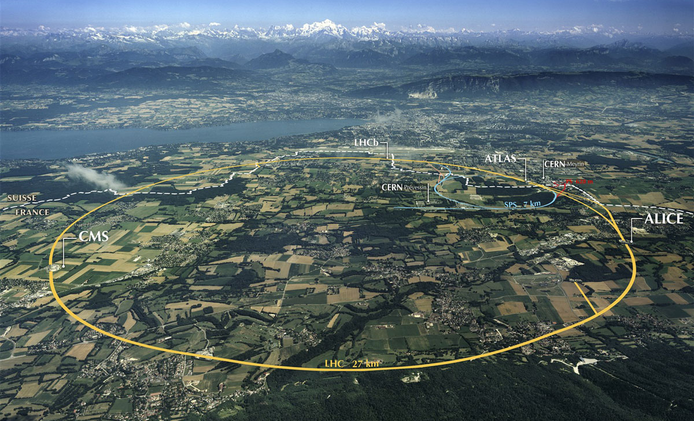
The Large Hadron Collider (LHC)
Largest and most powerful particle accelerator ever built (27 km circumference)
It is designed to:
store 450 GeV protons (in two counter rotating beams)
accelerate them up to 7 TeV
collide the two beams in four points of the ring (for high energy physics experiments)
Beam 2
Beam 1

Slide 5
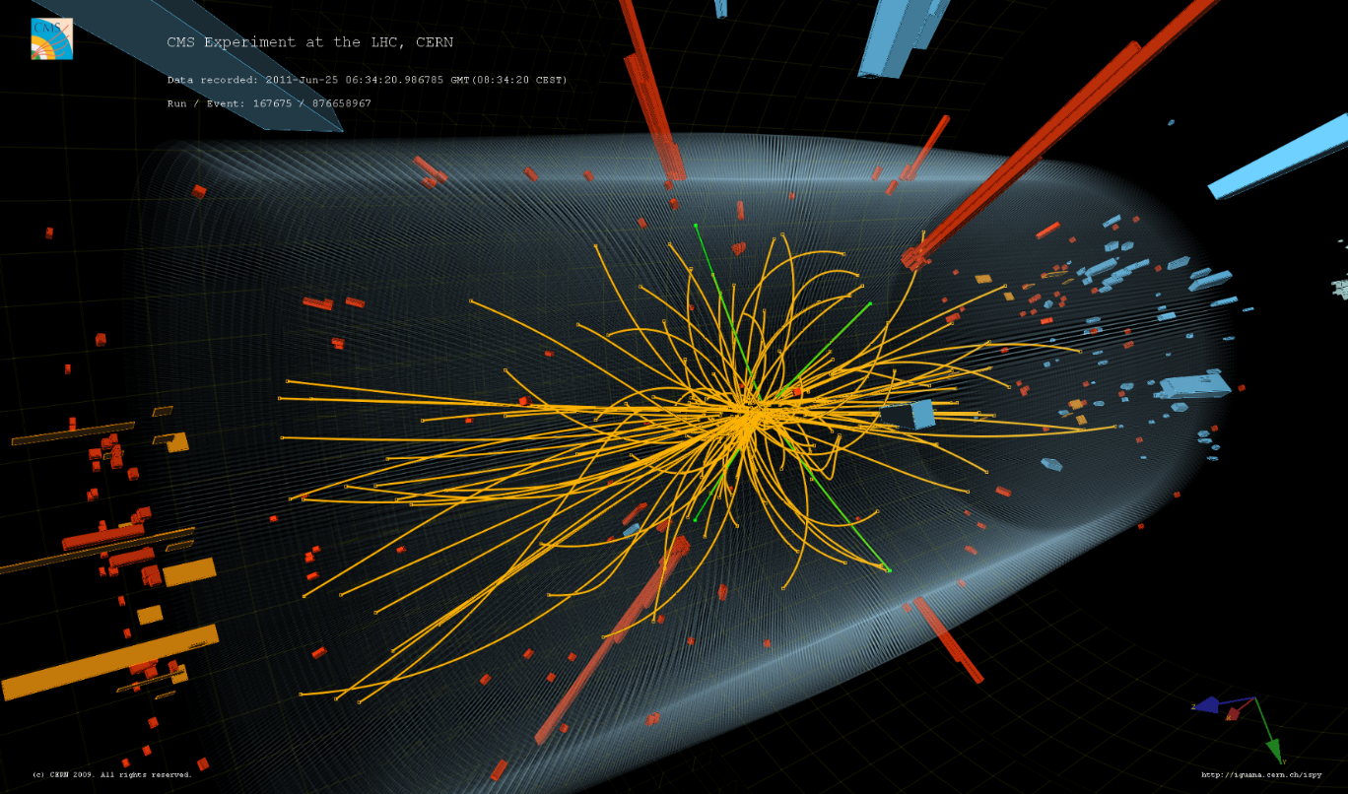
The Large Hadron Collider (LHC)
Largest and most powerful particle accelerator ever built (27 km circumference)
It is designed to:
store 450 GeV protons (in two counter rotating beams)
accelerate them up to 7 TeV
collide the two beams in four points of the ring (for high energy physics experiments)
Beam 2
Beam 1

Slide 6
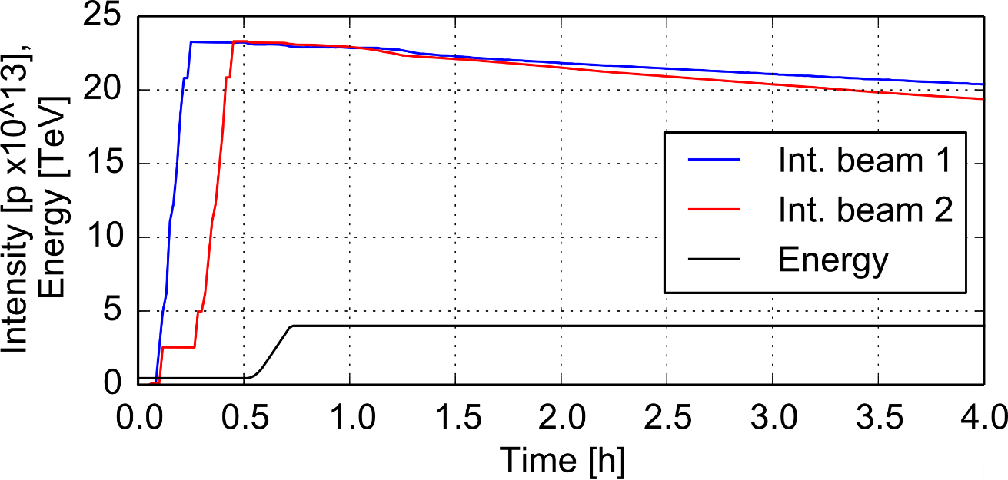
The Large Hadron Collider (LHC)
Largest and most powerful particle accelerator ever built (27 km circumference)
It is designed to:
store 450 GeV protons (in two counter rotating beams)
accelerate them up to 7 TeV
collide the two beams in four points of the ring (for high energy physics experiments)
A typical LHC fill
Injection
(~ 30 min.)
Prepare
for collision
(~30 min.)
Collisions
(several hours)
Beam 2
Beam 1
Acceleration
(~20 min.)

Slide 7
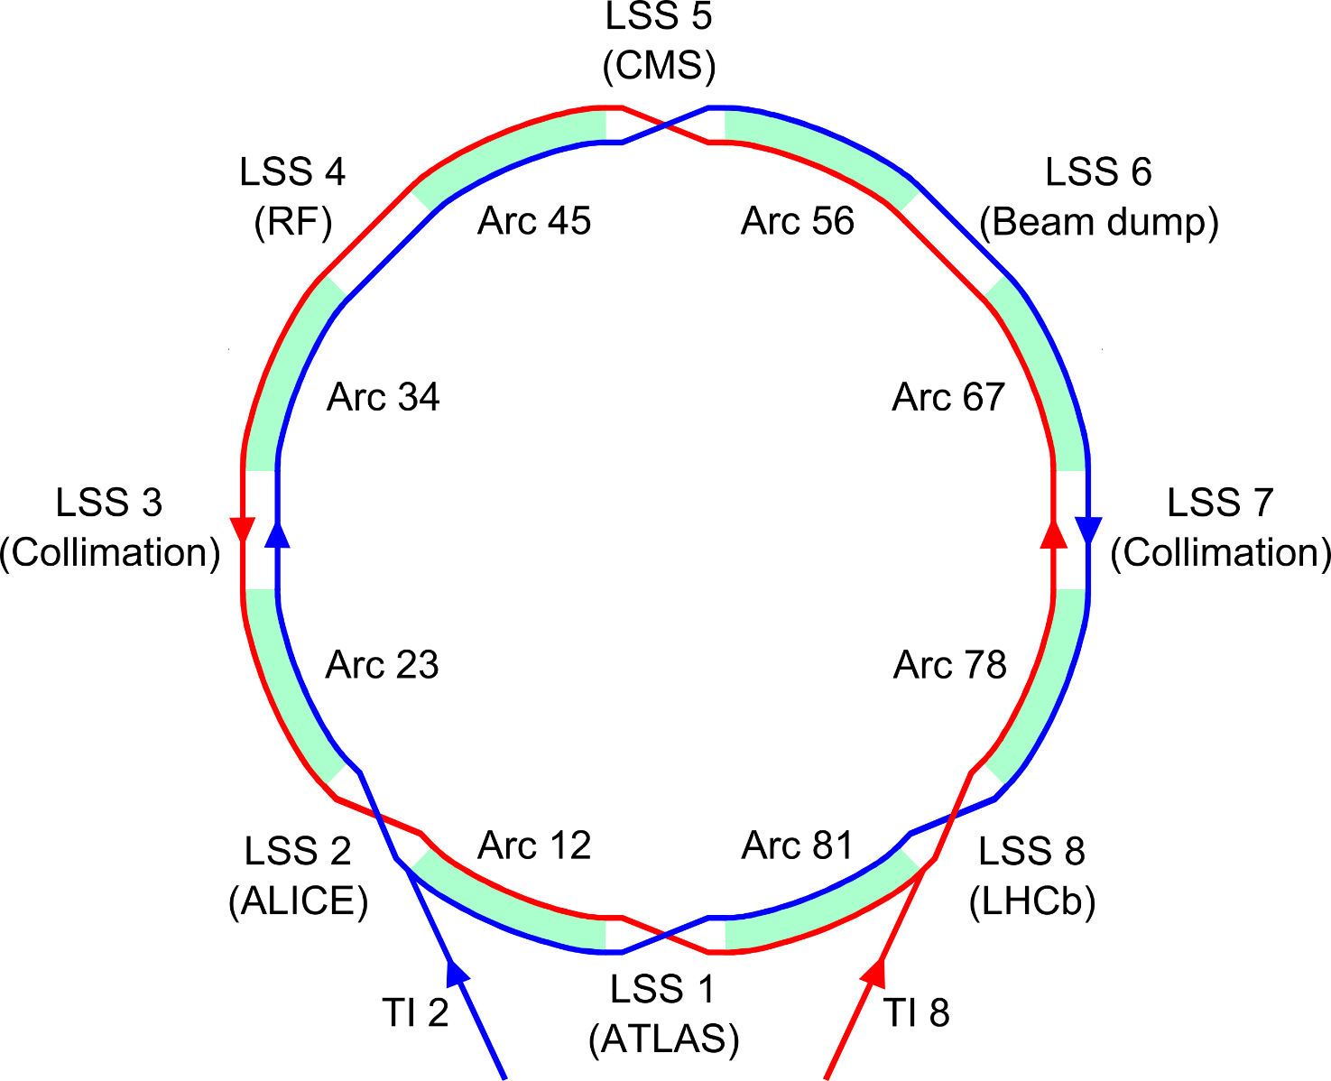
The Large Hadron Collider (LHC)
8-fold symmetric structure:
8 Long Straight Sections (LSS) to host experiments and other equipment
8 Arcs (2.45 km each - Periodic magnet lattice to bend and focus the beams)
Main magnets
(superconducting)
8.33 T dipoles
223 T/m quadrupoles

Slide 8
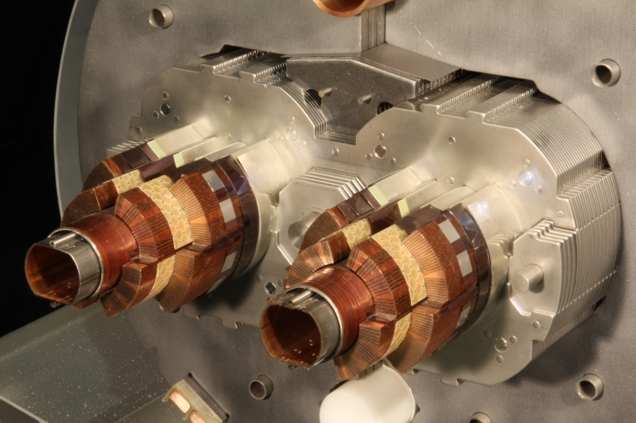
The Large Hadron Collider (LHC)
8-fold symmetric structure:
8 Long Straight Sections (LSS) to host experiments and other equipment
8 Arcs (2.45 km each - Periodic magnet lattice to bend and focus the beams)
Section of a main dipole
Beam screen cooling circuit
(liquid helium)
Superconducting coils (1.9 K)
Beam screen (5 – 20 K)
Main magnets
(superconducting)
8.33 T dipoles
223 T/m quadrupoles

Slide 9
Outline
Introduction
The Large Hadron Collider (LHC)
Electron Cloud effects
PyECLOUD: a new code for e-cloud buildup simulation
MacroParticle size management
Performances
E-cloud experimental studies at the LHC
Motivation
e-cloud effects with 25 ns beams at the LHC
Studies for a dedicated scrubbing beam

Slide 10
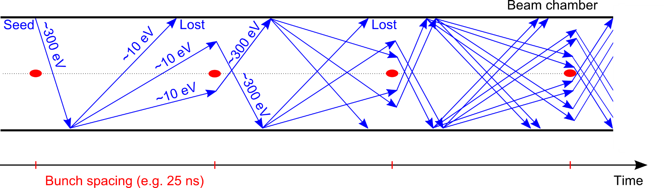
The electron cloud buildup
e⁻ is emitted (photoelectric effect)
Proton bunch

Slide 11
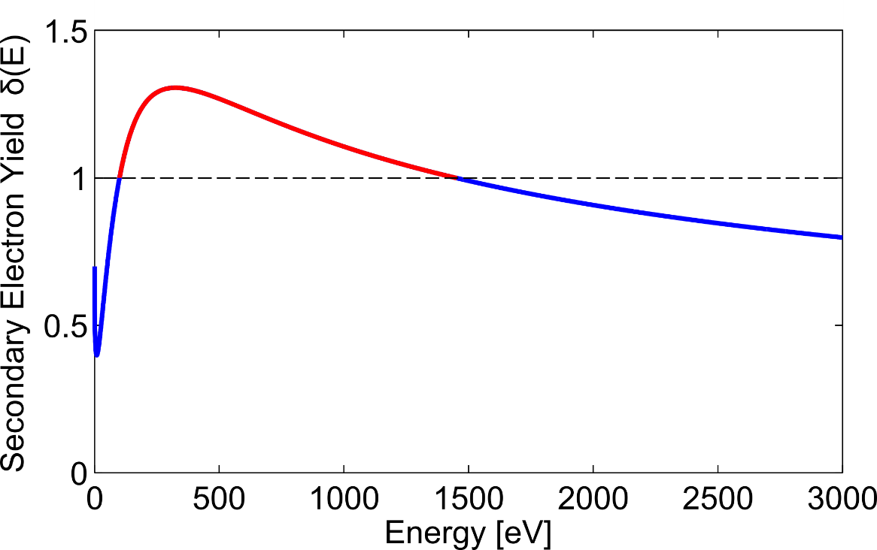
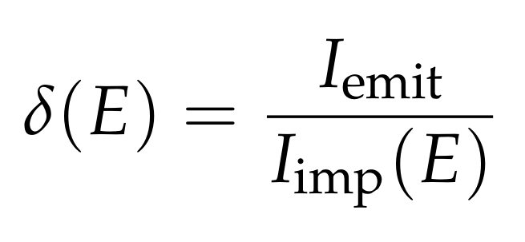
The electron cloud buildup
e⁻ is emitted (photoelectric effect)
Secondary Electron Emission
Proton bunch
SEY:

Slide 12
The electron cloud buildup
e⁻ is emitted (photoelectric effect)
If the SEY is large enough, Secondary Electron Emission can drive an avalanche multiplication effect filling the beam chamber with an electron cloud
Proton bunch

Slide 13
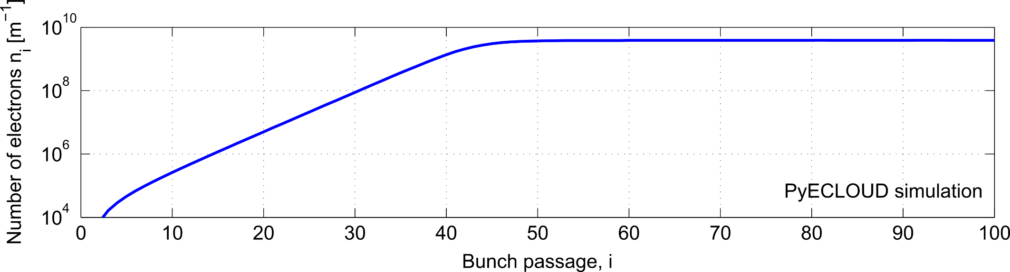

The electron cloud buildup
The electron density grows exponentially during the passage of the bunch train and then saturates (due to space charge effects within the cloud)
The trailing bunches of the train see the largest electron density

Slide 14

The electron cloud buildup
The electron density grows exponentially during the passage of the bunch train and then saturates (due to space charge effects within the cloud)
Something like this…
The trailing bunches of the train see the largest electron density

Slide 15
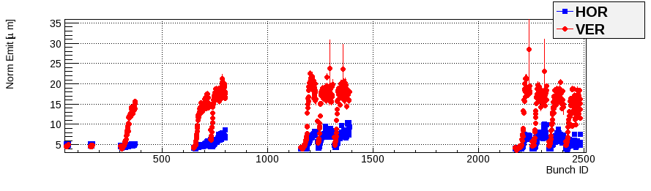
The electron cloud buildup
The presence of electron clouds in the beam chamber can have serious impact on the machine performance. The most common effects are:
Transverse beam instabilities (e.g. exponentially growing oscillation of beam position)
Transverse beam blow-up
Particle losses
Vacuum degradation
Heat load (critical in cryogenic magnets)
LHC Beam 1, 25 ns bunch spacing
Transverse emittance [a.u.]

Slide 16
Outline
Introduction
The Large Hadron Collider (LHC)
Electron Cloud effects
PyECLOUD: a new code for e-cloud buildup simulation
MacroParticle size management
Performances
E-cloud experimental studies at the LHC
Motivation
e-cloud effects with 25 ns beams at the LHC
Studies for a dedicated scrubbing beam

Slide 17
Ingredients for e-cloud build-up simulation
1. Seed electrons generation
(gas ionization, photoemission)
2. Force exerted by the beam on e⁻
3. Force exerted by the e⁻ on each other
(space charge)
4. Equations of motion
(also in presence of an external magnetic field)
5. Secondary emission

Slide 18
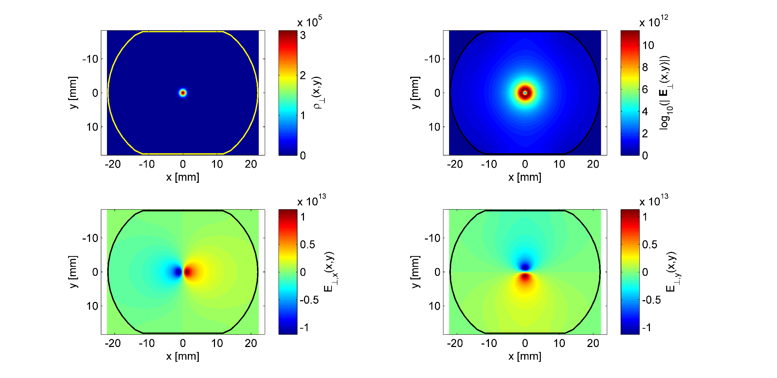
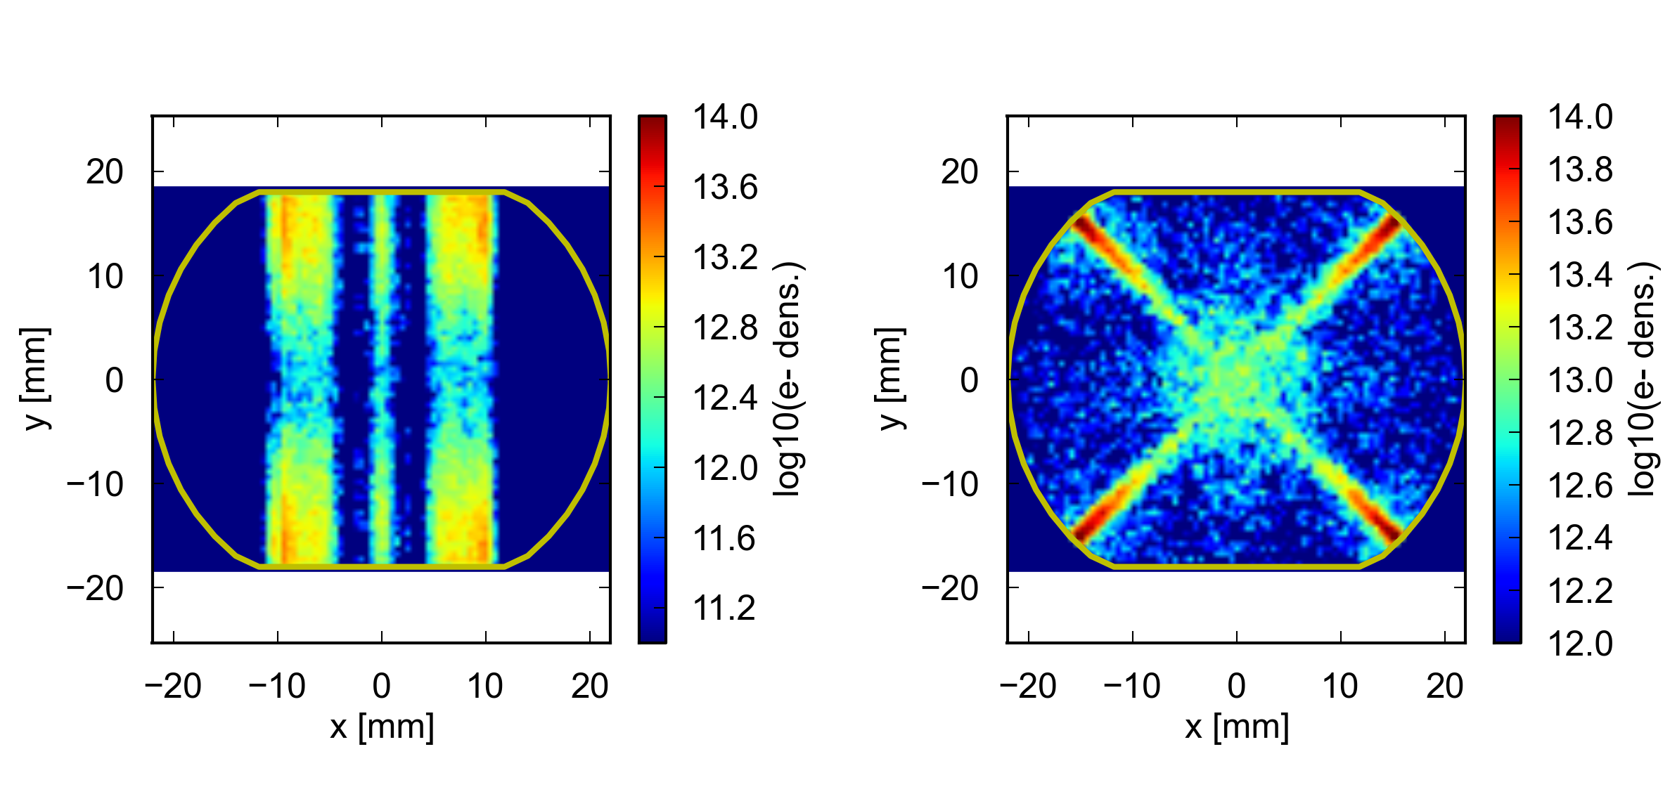


PyECLOUD
PyECLOUD is the EC buildup code developed during my PhD activity
In depth analysis of previously available tools → Small improvements practically everywhere
Several key features completely redesigned:
Beam field computation
Finite Difference → arbitrary chamber shape
Pre-saved map & interpolation → improved accuracy and speed
Electron cloud space charge
Particle In Cell → arbitrary chamber shape,
improved accuracy and speed
Electron tracking
Semi analytic algorithm for strong non uniform B field time step larger than cyclotron period → simulations for quadrupole and combined function magnets
Boris tracker → long term accuracy
Macroparticle Size Management
See next slides…
Written in Python (object oriented, open source)
Easy to develop and test (fundamental! we run thousands of simulations, a bug can waste months of work)
Flexible to extend (analysis of experimental data from CERN accelerators requires to simulate non ideal, complex situations… see second part of the talk)

Slide 19
Macroparticle size management
72 bunches – 25ns spac.
72 bunches – 25ns spac.
To make the computation affordable, the electrons are grouped in MacroParticles (MPs)
In an electron-cloud buildup, due to the multipacting process, the electron number extends over several orders of magnitude
It is practically impossible to choose a MP size that is suitable for the entire simulation (allowing a satisfactory description of the phenomenon and a computationally affordable number of MPs)

Slide 20
Macroparticle size management
72 bunches – 25ns spac.
72 bunches – 25ns spac.
A reference MP size N_{ref} (dynamically adapted during the simulation) is used to “take decisions”:
Seed MP generation: the generated MPs have size N_{ref}
Secondary MP emission: additional true secondary MPs are emitted if the total emitted charge is >1.5N_{ref}
MP cleaning: at each bunch passage a clean function is called to eliminate all the MPs with charge <10⁻⁴N_{ref}
x

Slide 21
Macroparticle size management
The reference MP size N_{ref} is adaptively changed during the simulation:
10.
MP
ref. size [m⁻¹]

Slide 22
Macroparticle size management
The reference MP size N_{ref} is adaptively changed during the simulation:
10.
MP
ref. size [m⁻¹]
MP reg.

Slide 23
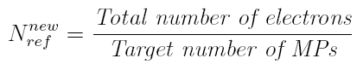

Macroparticle size management
The reference MP size N_{ref} is adaptively changed during the simulation:
MP set regeneration
Each macroparticle is assigned to a cell of a uniform grid in the 5-D space (x,y,v_{x},v_{y},v_{z}) obtaining an approximation of the phase space distribution
The new target MP size is chosen such that:
10.
MP
ref. size [m⁻¹]
MP reg.
A new MPs set, having the new reference size, is generated according to the computed distribution
The error on total charge and total energy does not go beyond 1-2%

Slide 24
Macroparticle size management
The reference MP size N_{ref} is adaptively changed during the simulation:
10.
45.
MP
ref. size [m⁻¹]
MP reg.

Slide 25
Macroparticle size management
The reference MP size N_{ref} is adaptively changed during the simulation:
10.
45.
MP
ref. size [m⁻¹]
MP reg.

Slide 26
Macroparticle size management
The reference MP size N_{ref} is adaptively changed during the simulation:
10.
45.
MP
ref. size [m⁻¹]
MP reg.

Slide 27
Macroparticle size management
The reference MP size N_{ref} is adaptively changed during the simulation:
10.
45.
2.1e2
1.1e3
5.5e3
2.9e4
1.3e5
3.1e5
3.6e5
MP
ref. size [m⁻¹]
MP reg.

Slide 28
Impact on the simulation performances
The newly introduced features had an evident impact on convergence properties and speed
ECLOUD (old code)
PyECLOUD
SPS MBB bending magnet, SEY_{max} = 1.5, nominal 25 ns beam, E=26 GeV

Slide 29
Impact on the simulation performances
The newly introduced features had an evident impact on convergence properties and speed
Timestep | ECLOUD | PYECLOUD
0.2 ns | 29 min | 12 min
0.1 ns | 1h 27 min | 13 min
0.05 ns | 1h 45 min | 24 min
0.025ns | 3h 7 min | 40 min
0.012ns | 4h 15 min | 1h 6 min
Simulation time [s]
Time step
SPS MBB bending magnet, SEY_{max} = 1.5, nominal 25 ns beam, E=26 GeV

Slide 30
Impact on the simulation performances
The newly introduced features had an evident impact on convergence properties and speed
PyECLOUD has quickly became the reference tool for electron cloud simulations for CERN machines, covering a variety of devices and beam conditions:
CERN Proton Synchrotron (PS, 26 GeV, 628 m ring)
Drift chambers, combined function magnets, electron cloud detectors
Several beam configuration and surface properties
Super Proton Synchrotron (SPS, 450 GeV, 7 Km ring)
Drift chambers, dipole magnets, electrostatic septa
Several beam configuration and surface properties
Large Hadron Collider (LHC, 7 TeV, 27 Km ring)
Drift chambers, dipole and quadrupole magnets, injection kickers, beam profile monitor, special common chambers, final focusing triplets
Several beam configuration and surface properties
Moreover:
Positron machines (PETRA III, Hamburg, Germany; CLIC linear collider damping ring – designs study)
Used in other institutes (FERMILAB, Chicago, USA; LAL, Orsay, France; DESY, Hamburg, Germany, UNISANNIO, Benevento, Italy)

Slide 31
Outline
Introduction
The Large Hadron Collider (LHC)
Electron Cloud effects
PyECLOUD: a new code for e-cloud buildup simulation
MacroParticle size management
Performances
E-cloud experimental studies at the LHC
Motivation
e-cloud effects with 25 ns beams at the LHC
Studies for a dedicated scrubbing beam

Slide 32
Experimental activity
Main goals and activities:
Analyze of electron cloud related observations during LHC (& injectors) operation
Propose → organize → perform → analyze dedicated electron cloud experiments aiming at:
Qualifying the behavior and performance limitations of the accelerators w.r.t. the electron cloud
Crosscheck and improve our models and simulation codes (to be able to make reliable predictions for future operation scenarios)
Study possible countermeasures

Slide 33
Bunch spacing
Bunch spacing is a key parameter for electron cloud effects
→ it changes the SEY requirement to suppress the electron cloud
PyECLOUD simulations
Bunch spacing
Bunch spacing:
25 ns ←→ 7.5 m 50 ns ←→ 15 m

Slide 34
Quick historical recap
We had three years of LHC beam operation: 2010-2012
 | Energy | Bunch population | Bunch spacing | Number of bunches | Integrated Luminosity/ year
Design | 7 TeV | 1.15x10¹¹ p⁺ | 25 ns | 2808

Slide 35
Quick historical recap
We had three years of LHC beam operation: 2010-2012
 | Energy | Bunch population | Bunch spacing | Number of bunches | Integrated Luminosity/ year
Design | 7 TeV | 1.15x10¹¹ p⁺ | 25 ns | 2808
2010 | 3.5 TeV | 1.2x10¹¹ p⁺ | 150 ns | 368 | 0.04 fb⁻¹

Slide 36
Quick historical recap
We had three years of LHC beam operation: 2010-2012
 | Energy | Bunch population | Bunch spacing | Number of bunches | Integrated Luminosity/ year
Design | 7 TeV | 1.15x10¹¹ p⁺ | 25 ns | 2808
2010 | 3.5 TeV | 1.2x10¹¹ p⁺ | 150 ns | 368 | 0.04 fb⁻¹
 | Attempt to switch to 50 ns spacing: failed due to electron cloud effects!

Slide 37
Quick historical recap
We had three years of LHC beam operation: 2010-2012
 | Energy | Bunch population | Bunch spacing | Number of bunches | Integrated Luminosity/ year
Design | 7 TeV | 1.15x10¹¹ p⁺ | 25 ns | 2808
2010 | 3.5 TeV | 1.2x10¹¹ p⁺ | 150 ns | 368 | 0.04 fb⁻¹
 | Attempt to switch to 50 ns spacing: failed due to electron cloud effects!
2011 | Operation re-started with 75 ns bunch spacing Scrubbing run to lower the SEY and enable 50 ns operation

Slide 38
Quick historical recap
We had three years of LHC beam operation: 2010-2012
 | Energy | Bunch population | Bunch spacing | Number of bunches | Integrated Luminosity/ year
Design | 7 TeV | 1.15x10¹¹ p⁺ | 25 ns | 2808
2010 | 3.5 TeV | 1.2x10¹¹ p⁺ | 150 ns | 368 | 0.04 fb⁻¹
 | Attempt to switch to 50 ns spacing: failed due to electron cloud effects!
2011 | Operation re-started with 75 ns bunch spacing Scrubbing run to lower the SEY and enable 50 ns operation
Beam induced scrubbing
Keeping a significant e⁻ flux on the chamber’s walls causes a decrease of the SEY (and hence the e-cloud) → the electron cloud cures itself
During dedicated Scrubbing Runs we try to provoke as much e-cloud as possible to condition the chamber’s walls
Scrubbing of Cu measured with e⁻ at 500eV (CERN TE-VSC)
PyECLOUD simulations

Slide 39
Quick historical recap
We had three years of LHC beam operation: 2010-2012
 | Energy | Bunch population | Bunch spacing | Number of bunches | Integrated Luminosity/ year
Design | 7 TeV | 1.15x10¹¹ p⁺ | 25 ns | 2808
2010 | 3.5 TeV | 1.2x10¹¹ p⁺ | 150 ns | 368 | 0.04 fb⁻¹
 | Attempt to switch to 50 ns spacing: failed due to electron cloud effects!
2011 | Operation re-started with 75 ns bunch spacing Scrubbing run to lower the SEY and enable 50 ns operation

Slide 40
Quick historical recap
We had three years of LHC beam operation: 2010-2012
 | Energy | Bunch population | Bunch spacing | Number of bunches | Integrated Luminosity/ year
Design | 7 TeV | 1.15x10¹¹ p⁺ | 25 ns | 2808
2010 | 3.5 TeV | 1.2x10¹¹ p⁺ | 150 ns | 368 | 0.04 fb⁻¹
 | Attempt to switch to 50 ns spacing: failed due to electron cloud effects!
2011 | Operation re-started with 75 ns bunch spacing Scrubbing run to lower the SEY and enable 50 ns operation → successful!

Slide 41
Quick historical recap
We had three years of LHC beam operation: 2010-2012
 | Energy | Bunch population | Bunch spacing | Number of bunches | Integrated Luminosity/ year
Design | 7 TeV | 1.15x10¹¹ p⁺ | 25 ns | 2808
2010 | 3.5 TeV | 1.2x10¹¹ p⁺ | 150 ns | 368 | 0.04 fb⁻¹
 | Attempt to switch to 50 ns spacing: failed due to electron cloud effects!
2011 | Operation re-started with 75 ns bunch spacing Scrubbing run to lower the SEY and enable 50 ns operation → successful!
 | 3.5 TeV | 1.45x10¹¹ p⁺ | 50 ns | 1380 | 6.1 fb⁻¹

Slide 42
Quick historical recap
We had three years of LHC beam operation: 2010-2012
 | Energy | Bunch population | Bunch spacing | Number of bunches | Integrated Luminosity/ year
Design | 7 TeV | 1.15x10¹¹ p⁺ | 25 ns | 2808
2010 | 3.5 TeV | 1.2x10¹¹ p⁺ | 150 ns | 368 | 0.04 fb⁻¹
 | Attempt to switch to 50 ns spacing: failed due to electron cloud effects!
2011 | Operation re-started with 75 ns bunch spacing Scrubbing run to lower the SEY and enable 50 ns operation → successful!
 | 3.5 TeV | 1.45x10¹¹ p⁺ | 50 ns | 1380 | 6.1 fb⁻¹
2012 | Thanks to scrubbing from 2011, operation could be resumed with 50 ns spacing
 | 4 TeV | 1.7x10¹¹ p⁺ | 50 ns | 1380 | 23.1 fb⁻¹

Slide 43
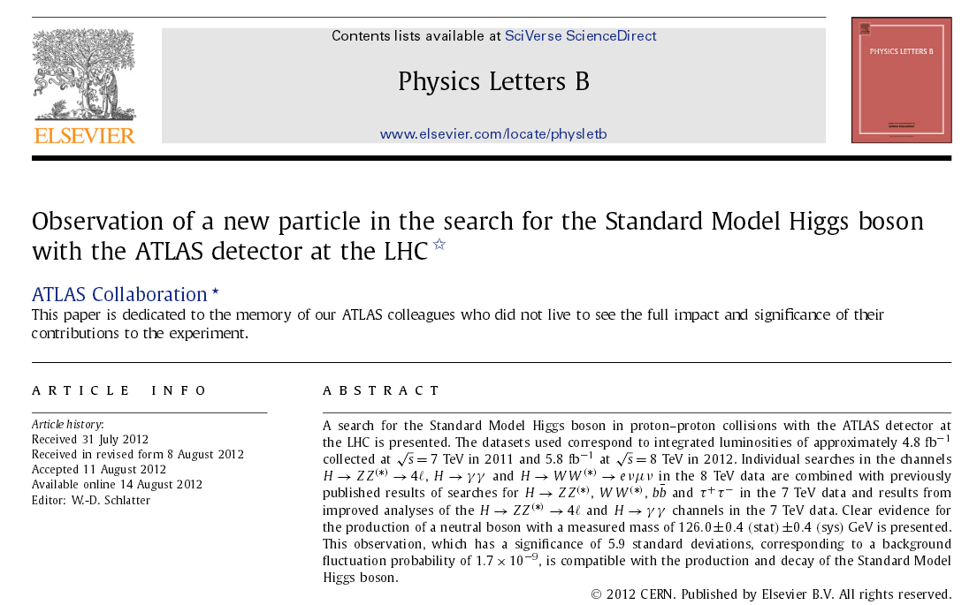


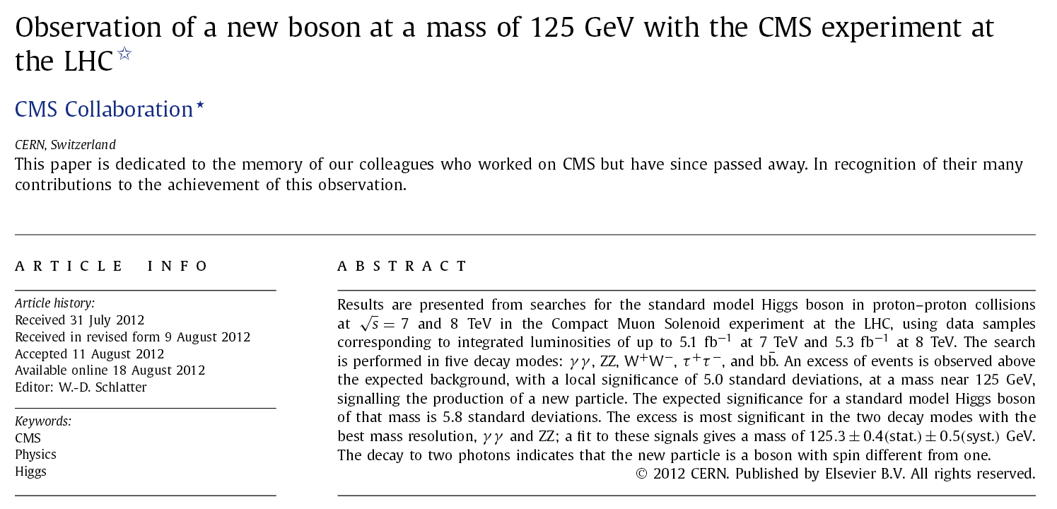
Quick historical recap
We had three years of LHC beam operation: 2010-2012
 | Energy | Bunch population | Bunch spacing | Number of bunches | Integrated Luminosity/ year
Design | 7 TeV | 1.15x10¹¹ p⁺ | 25 ns | 2808
2010 | 3.5 TeV | 1.2x10¹¹ p⁺ | 150 ns | 368 | 0.04 fb⁻¹
 | Attempt to switch to 50 ns spacing: failed due to electron cloud effects!
2011 | Operation re-started with 75 ns bunch spacing Scrubbing run to lower the SEY and enable 50 ns operation → successful!
 | 3.5 TeV | 1.45x10¹¹ p⁺ | 50 ns | 1380 | 6.1 fb⁻¹
2012 | Thanks to scrubbing from 2011, operation could be resumed with 50 ns spacing
 | 4 TeV | 1.7x10¹¹ p⁺ | 50 ns | 1380 | 23.1 fb⁻¹

Slide 44
Quick historical recap
We had three years of LHC beam operation: 2010-2012
 | Energy | Bunch population | Bunch spacing | Number of bunches | Integrated Luminosity/ year
Design | 7 TeV | 1.15x10¹¹ p⁺ | 25 ns | 2808
2010 | 3.5 TeV | 1.2x10¹¹ p⁺ | 150 ns | 368 | 0.04 fb⁻¹
 | Attempt to switch to 50 ns spacing: failed due to electron cloud effects!
2011 | Operation re-started with 75 ns bunch spacing Scrubbing run to lower the SEY and enable 50 ns operation → successful!
 | 3.5 TeV | 1.45x10¹¹ p⁺ | 50 ns | 1380 | 6.1 fb⁻¹
2012 | Thanks to scrubbing from 2011, operation could be resumed with 50 ns spacing
 | 4 TeV | 1.7x10¹¹ p⁺ | 50 ns | 1380 | 23.1 fb⁻¹

Slide 45
Quick historical recap
We had three years of LHC beam operation: 2010-2012
 | Energy | Bunch population | Bunch spacing | Number of bunches | Integrated Luminosity/ year
Design | 7 TeV | 1.15x10¹¹ p⁺ | 25 ns | 2808
2010 | 3.5 TeV | 1.2x10¹¹ p⁺ | 150 ns | 368 | 0.04 fb⁻¹
 | Attempt to switch to 50 ns spacing: failed due to electron cloud effects!
2011 | Operation re-started with 75 ns bunch spacing Scrubbing run to lower the SEY and enable 50 ns operation → successful!
 | 3.5 TeV | 1.45x10¹¹ p⁺ | 50 ns | 1380 | 6.1 fb⁻¹
2012 | Thanks to scrubbing from 2011, operation could be resumed with 50 ns spacing
 | 4 TeV | 1.7x10¹¹ p⁺ | 50 ns | 1380 | 23.1 fb⁻¹
2013 - 14 | Long shutdown: maintenance and consolidation

Slide 46
Quick historical recap
We had three years of LHC beam operation: 2010-2012
 | Energy | Bunch population | Bunch spacing | Number of bunches | Integrated Luminosity/ year
Design | 7 TeV | 1.15x10¹¹ p⁺ | 25 ns | 2808
2010 | 3.5 TeV | 1.2x10¹¹ p⁺ | 150 ns | 368 | 0.04 fb⁻¹
 | Attempt to switch to 50 ns spacing: failed due to electron cloud effects!
2011 | Operation re-started with 75 ns bunch spacing Scrubbing run to lower the SEY and enable 50 ns operation → successful!
 | 3.5 TeV | 1.45x10¹¹ p⁺ | 50 ns | 1380 | 6.1 fb⁻¹
2012 | Thanks to scrubbing from 2011, operation could be resumed with 50 ns spacing
 | 4 TeV | 1.7x10¹¹ p⁺ | 50 ns | 1380 | 23.1 fb⁻¹
2013 - 14 | Long shutdown: maintenance and consolidation
2015 - … | 6.5 TeV | 1.15x10¹¹ p⁺ | 25 ns | 2604 | ~50 fb⁻¹

Slide 47
Quick historical recap
We had three years of LHC beam operation: 2010-2012
 | Energy | Bunch population | Bunch spacing | Number of bunches | Integrated Luminosity/ year
Design | 7 TeV | 1.15x10¹¹ p⁺ | 25 ns | 2808
2010 | 3.5 TeV | 1.2x10¹¹ p⁺ | 150 ns | 368 | 0.04 fb⁻¹
 | Attempt to switch to 50 ns spacing: failed due to electron cloud effects!
2011 | Operation re-started with 75 ns bunch spacing Scrubbing run to lower the SEY and enable 50 ns operation → successful!
 | 3.5 TeV | 1.45x10¹¹ p⁺ | 50 ns | 1380 | 6.1 fb⁻¹
2012 | Thanks to scrubbing from 2011, operation could be resumed with 50 ns spacing
 | 4 TeV | 1.7x10¹¹ p⁺ | 50 ns | 1380 | 23.1 fb⁻¹
2013 - 14 | Long shutdown: maintenance and consolidation
2015 - … | 6.5 TeV | 1.15x10¹¹ p⁺ | 25 ns | 2604 | ~50 fb⁻¹
 | Need to stick to nominal bunch population → 25 ns mandatory to reach the luminosity goal

Slide 48
Quick historical recap
We had three years of LHC beam operation: 2010-2012
 | Energy | Bunch population | Bunch spacing | Number of bunches | Integrated Luminosity/ year
Design | 7 TeV | 1.15x10¹¹ p⁺ | 25 ns | 2808
2010 | 3.5 TeV | 1.2x10¹¹ p⁺ | 150 ns | 368 | 0.04 fb⁻¹
 | Attempt to switch to 50 ns spacing: failed due to electron cloud effects!
2011 | Operation re-started with 75 ns bunch spacing Scrubbing run to lower the SEY and enable 50 ns operation → successful!
 | 3.5 TeV | 1.45x10¹¹ p⁺ | 50 ns | 1380 | 6.1 fb⁻¹
2012 | Thanks to scrubbing from 2011, operation could be resumed with 50 ns spacing
 | 4 TeV | 1.7x10¹¹ p⁺ | 50 ns | 1380 | 23.1 fb⁻¹
2013 - 14 | Long shutdown: maintenance and consolidation
2015 - … | 6.5 TeV | 1.15x10¹¹ p⁺ | 25 ns | 2604 | ~50 fb⁻¹
 | Need to stick to nominal bunch population → 25 ns mandatory to reach the luminosity goal
e-cloud effects with 25 ns spacing are much more severe
Operation with nominal number of bunches experimentally not proved yet
We needed to:
Qualify the performance limitations (heat loads, vacuum, beam dynamics)
Define a possible mitigation strategy
Addressed in this thesis work both with simulation and experimental studies (mainly in dedicated machine sessions)

Slide 49
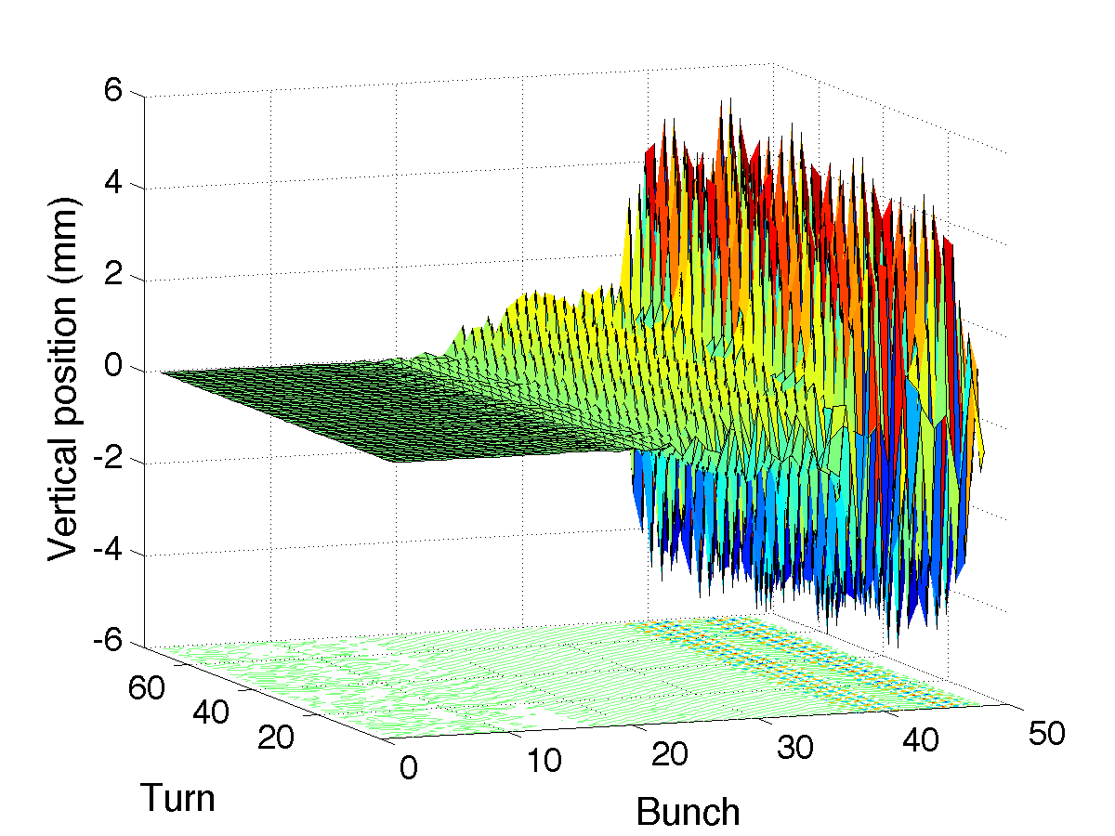
Electron cloud effects with 25ns: 2011 experience
First injection tests with a train of 48b. on 26/08/2011:
Beam unstable right after injection (dump due to losses after 3 sec)
Probably driven by e-cloud in the dipoles (mainly vertical motion, trailing bunches of the train)
~ bunch 25 is the first unstable
up to ±5mm
H. Bartosik, W. Höfle, G. Iadarola, Y. Papaphilippou, and G. Rumolo, “Benchmarking HEADTAIL with electron cloud instabilities observed in the LHC,” Proceedings of ECLOUD12: Joint INFN-CERN-EuCARD-AccNet Workshop on Electron-Cloud Effects, La Biodola, Isola d’Elba, Italy, 2012

Slide 50
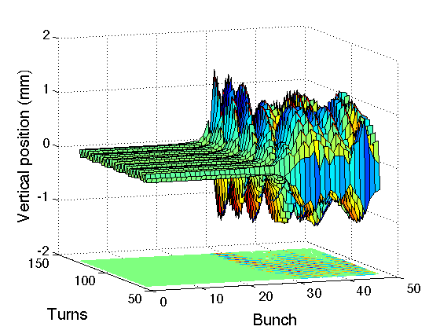
Electron cloud effects with 25ns: 2011 experience
First injection tests with a train of 48b. on 26/08/2011:
Beam unstable right after injection (dump due to losses)
Probably driven by e-cloud in the dipoles (mainly vertical motion, trailing bunches of the train)
The instability could be successfully reproduced using PyECLOUD-HEADTAIL simulations
bunch 26 is the first unstable
~ bunch 25 is the first unstable
up to ±5mm
H. Bartosik, W. Höfle, G. Iadarola, Y. Papaphilippou, and G. Rumolo, “Benchmarking HEADTAIL with electron cloud instabilities observed in the LHC,” Proceedings of ECLOUD12: Joint INFN-CERN-EuCARD-AccNet Workshop on Electron-Cloud Effects, La Biodola, Isola d’Elba, Italy, 2012

Slide 51
2011 experience with 25 ns beams: scrubbing tests
First scrubbing tests with 25ns (450 GeV):
Running with high chromaticity to avoid EC driven instabilities
Injected up to 2100b. for B1 and 1020b. for B2
Strong heat load observed in the cryogenic arcs
Important beam degradation
Beam 1
Beam 2
Energy
29/06
07/10
14/10
24-25/10

Slide 52
Electron cloud effects with 25ns: 2011 experience
We devised a method to reconstruct the SEY of the vacuum chamber based on the heat load measurements from the cryogenics:
Based on PyECLOUD simulations with measured beam profiles (mandatory to get reliable results)
29/06
07/10
14/10
24-25/10
50ns
25ns threshold @450 GeV
G. Iadarola and G. Rumolo, “Electron cloud in the CERN accelerators (PS, SPS, LHC),” Proceedings of ECLOUD12: Joint INFN-CERN-EuCARD-AccNet Workshop on Electron-Cloud Effects, La Biodola, Isola d’Elba, Italy, 2012.

Slide 53
Electron cloud effects with 25ns: 2011 experience
We devised a method to reconstruct the SEY of the vacuum chamber based on the heat load measurements from the cryogenics:
Based on PyECLOUD simulations with measured beam profiles (mandatory to get reliable results)
An important benchmark for our models came from bunch by bunch energy loss estimation based on stable phase measurements
29/06
07/10
14/10
24-25/10
50ns
25ns threshold @450 GeV
J. F. Esteban-Müller, P. Baudrenghien, G. Iadarola, T. Mastoridis, G. Papotti, G. Rumolo, E. Shaposhnikova, and D. Valuch, “Synchronous Phase Shift at LHC,” Proceedings of ECLOUD12,La Biodola, Isola d’Elba, Italy, 2012.

Slide 54
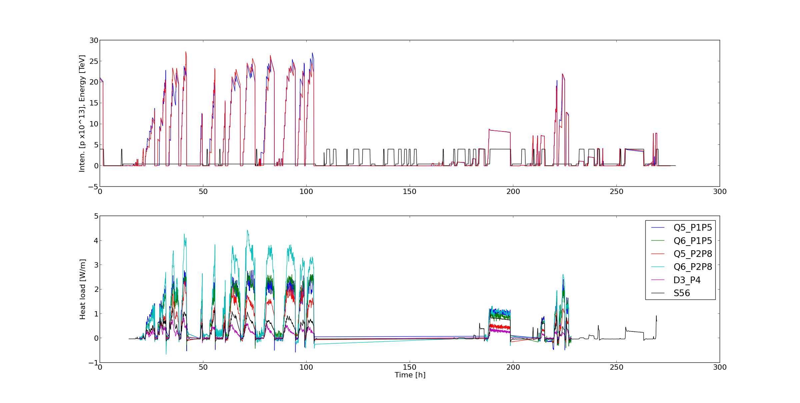
The “25 ns run” in 2012
More time for experiments with 25 ns beams and large number of bunches
→ concentrated the last 10 days of the run
Test fills
at 450 GeV
Access + setup for β*=1m
Scrubbing run (450GeV)
(6 – 10 Dec 2012)
MDs with 25ns at 4TeV
(12 – 15 Dec 2012)
Pilot physics run
with 25ns beams
(15 – 17 Dec 2012)

Slide 55
The 2012 scrubbing run
3.5 days of scrubbing with 25ns beams at 450 GeV (6 - 9 Dec. 2012):
Filling the ring with up to 2748b. (record!) per beam (up to 2.7x10¹⁴ p – record!)
Slow improvement visible on beam quality and heat load in the arcs
Beam 1
Beam 2

Slide 56
The 2012 scrubbing run
3.5 days of scrubbing with 25ns beams at 450 GeV (6 - 9 Dec. 2012):
Filling the ring with up to 2748b. (record!) per beam (up to 2.7x10¹⁴ p – record!)
Slow improvement visible on beam quality and heat load in the arcs
Beam 1
Beam 2

Slide 57
Experience with 25 ns beams at 4 TeV
The accumulated scrubbing made possible to have machine studies and a pilot physics run with 25 ns at 4 TeV
804b.
804b.
780b.
84b.
156b.
372b.
108b.
204b.
396b.
Machine Studies
with 25 ns beams at 4TeV
(12 – 15 Dec 2012)
Pilot physics run
with 25ns beams
(15 – 17 Dec 2012)

Slide 58
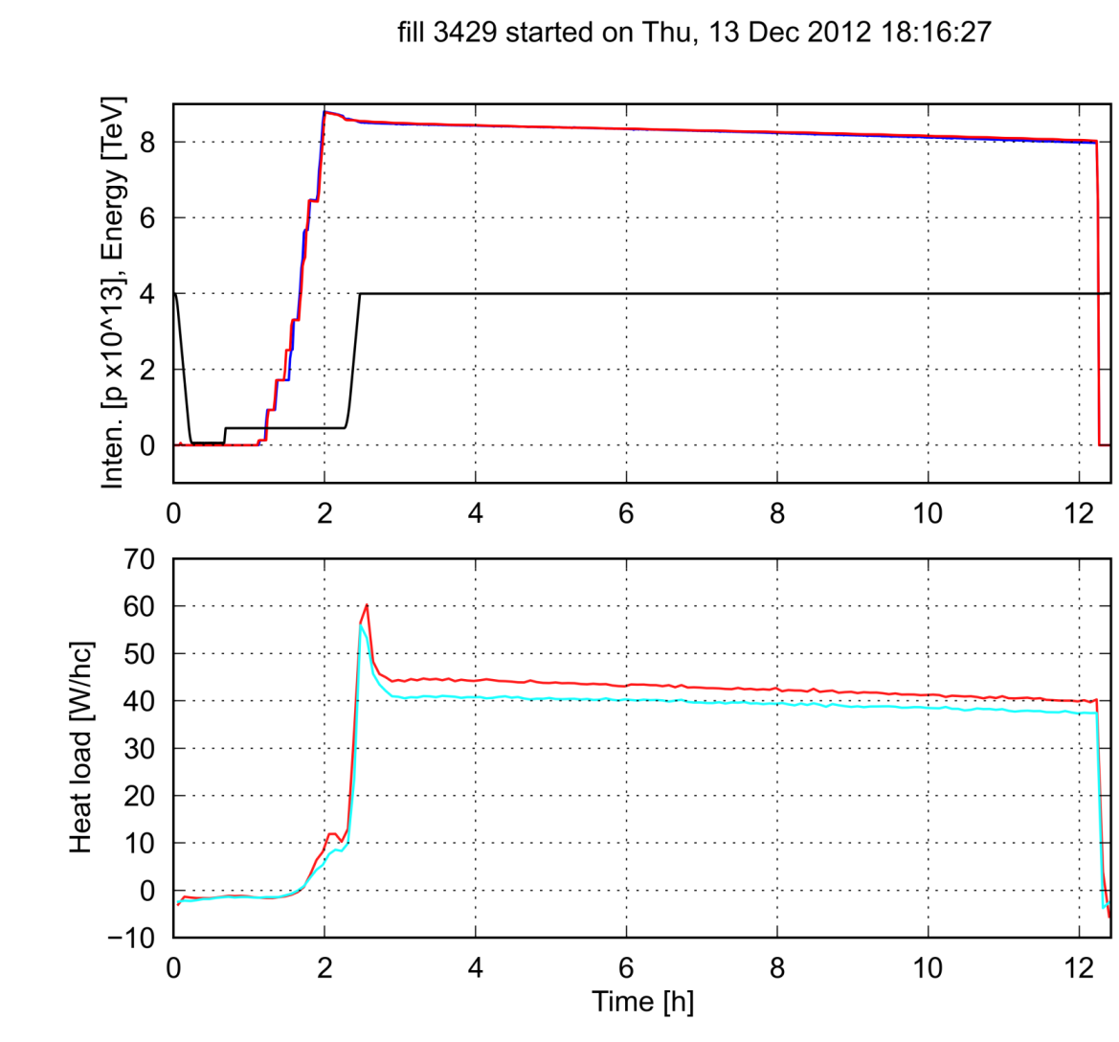
Experience with 25 ns beams at 4 TeV
A strong enhancement on the heat load is observed on the energy ramp
Rescaling to the nominal number of bunches it exceeds the cooling capacity of the cryogenics!
<S56>
<S67>

Slide 59
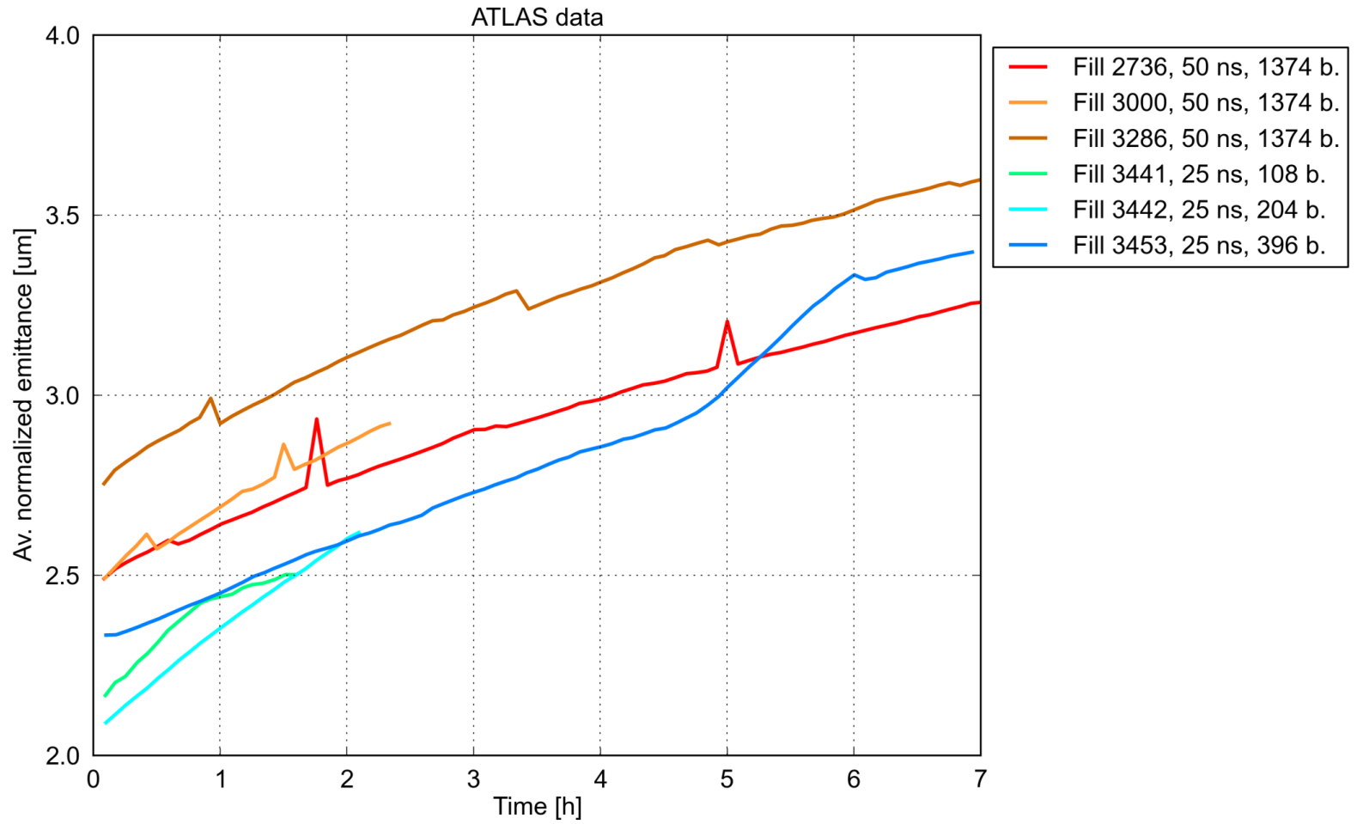
Experience with 25 ns beams at 4 TeV
A strong enhancement on the heat load is observed on the energy ramp
Large electron cloud density in the arcs does not show a strong effect on the beam (due to increased beam rigidity)
Emittance blow-up in collision very similar to 50 ns → likely not due to EC
50 ns
1.45 – 1.6 x 10¹¹ ppb
25 ns
1.0 – 1.1 x 10¹¹ ppb

Slide 60
Scrubbing: we need to do better!
Experience in Run 1 showed that the electron cloud can limit the achievable performance with 25 ns beams mainly through:
beam degradation (blow-up, losses) at low energy
high heat load on arc beam screens at high energy
To operate with 25 ns beams (~2800b.) it is mandatory to achieve lower values in SEY
Dedicated scrubbing beams with hybrid bunch spacing are presently under study
LHC dipole
Scrubbing beam (5+20) ns
Standard beam 25 ns
Electron density [a. u.]
PyECLOUD simulations

Slide 61
Scrubbing: we need to do better!
Experience in Run 1 showed that the electron cloud can limit the achievable performance with 25 ns beams mainly through:
beam degradation (blow-up, losses) at low energy
high heat load on arc beam screens at high energy
To operate with 25 ns beams (~2800b.) it is mandatory to achieve lower values in SEY
Dedicated scrubbing beams with hybrid bunch spacing are presently under study → production scheme with non adiabatic splitting @ SPS injection
25 ns
25 ns

Slide 62
Scrubbing: we need to do better!
Experience in Run 1 showed that the electron cloud can limit the achievable performance with 25 ns beams mainly through:
beam degradation (blow-up, losses) at low energy
high heat load on arc beam screens at high energy
To operate with 25 ns beams (~2800b.) it is mandatory to achieve lower values in SEY
Dedicated scrubbing beams with hybrid bunch spacing are presently under study → production scheme with non adiabatic splitting
25 ns
25 ns

Slide 63
Scrubbing: we need to do better!
Experience in Run 1 showed that the electron cloud can limit the achievable performance with 25 ns beams mainly through:
beam degradation (blow-up, losses) at low energy
high heat load on arc beam screens at high energy
To operate with 25 ns beams (~2800b.) it is mandatory to achieve lower values in SEY
Dedicated scrubbing beams with hybrid bunch spacing are presently under study → proved experimentally at SPS
4
3
1st inj.
200 MHz RF Voltage [MV]
2
1
0
4
-1
0
2
6
6
Time [ms]

Slide 64
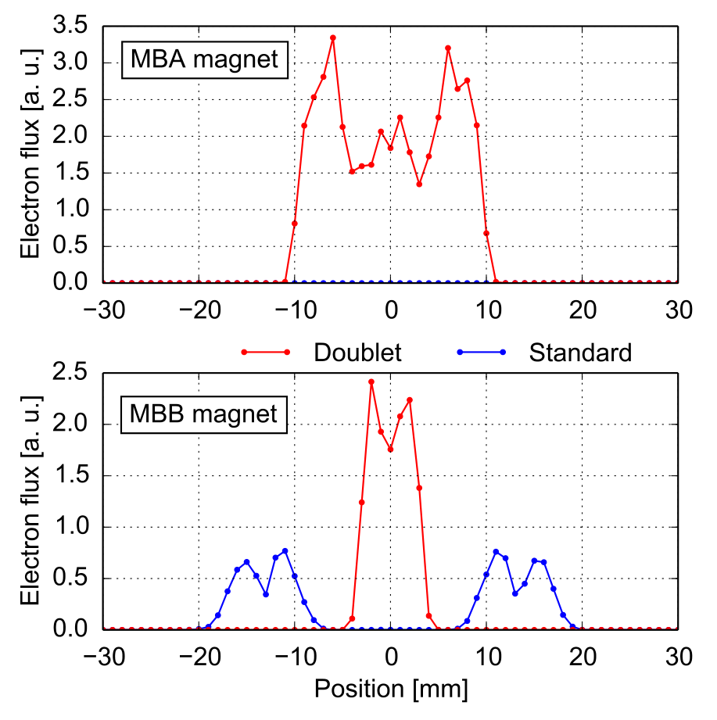
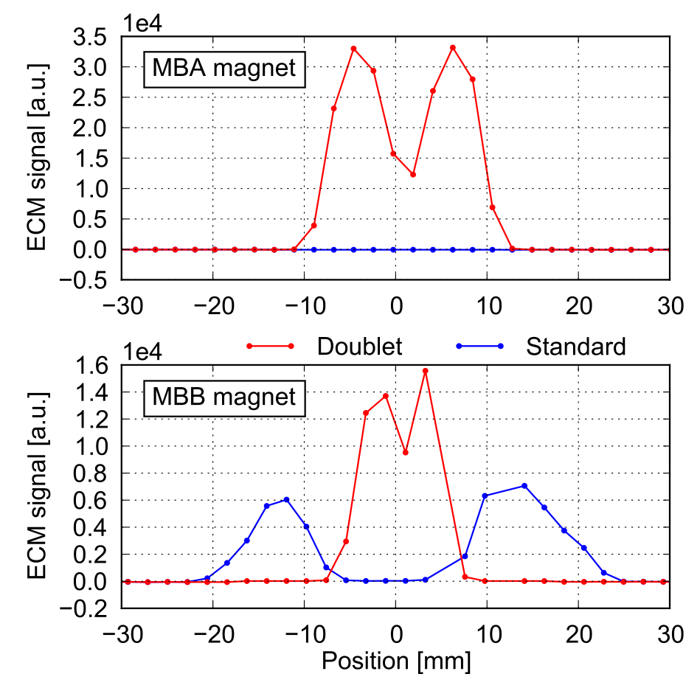
Scrubbing: we need to do better!
Experience in Run 1 showed that the electron cloud can limit the achievable performance with 25 ns beams mainly through:
beam degradation (blow-up, losses) at low energy
high heat load on arc beam screens at high energy
To operate with 25 ns beams (~2800b.) it is mandatory to achieve lower values in SEY
Dedicated scrubbing beams with hybrid bunch spacing are presently under study → proved experimentally at SPS
PyECLOUD simulation
Measurement

Slide 65
Summary
The Electron Cloud Buildup in the LHC and its injector complex has been addressed with simulation and experimental studies
PyECLOUD, a new code for the simulation of the electron cloud buildup, has been developed
The newly implemented solutions had a evident impact on accuracy, speed, and usage flexibility (compared to other tools)
Simulation and experimental studies have addressed the electron cloud issues at the LHC (with particular emphasis on 25 ns bunch spacing)
Main limitations have been identified (beam degradation at 450 GeV and heat load at 4 – 7 TeV)
A mitigation strategy (including the use of a specifically designed scrubbing beam) has been defined

Slide 66
Not covered in this presentation
Extensive simulation studies for the LHC arc components
Relative contribution of dipoles and quadrupoles (confirmed experimentally)
Dependence on bunch intensity, bunch length, transverse size
Simulation and experimental studies for the LHC interaction regions
800 mm common chamber at the ALICE experiment
Inner triplets (present & High Luminosity Upgrade)
Simulation and experimental studies for the LHC injector complex (PS and SPS)
Pre-shutdown machine qualification w.r.t. e-cloud
LHC injectors upgrade scenarios
Scrubbing and mitigation strategies

Slide 67
Thanks for your attention!
Thanks to:
G. Arduini, H. Bartosik, D. Banfi, V. Baglin, C. Bhat, R. De Maria, O. Dominguez,
M. Driss Mensi, E. Metral, J. Esteban-Muller, W. Hofle, K. Li, H. Maury Cuna, H. Neupert, T. Pieloni,
G. Papotti, F. Roncarolo, E. Shaposhnikova, M. Taborelli, L. Tavian, G. Trad, C. Y. Vallgren,
D. Valuch, C. Zannini, F. Zimmermann
ABP, Collimation, Cryogenics, EN/STI, Injection, Operation, Transverse Damper, Vacuum teams

Slide 68
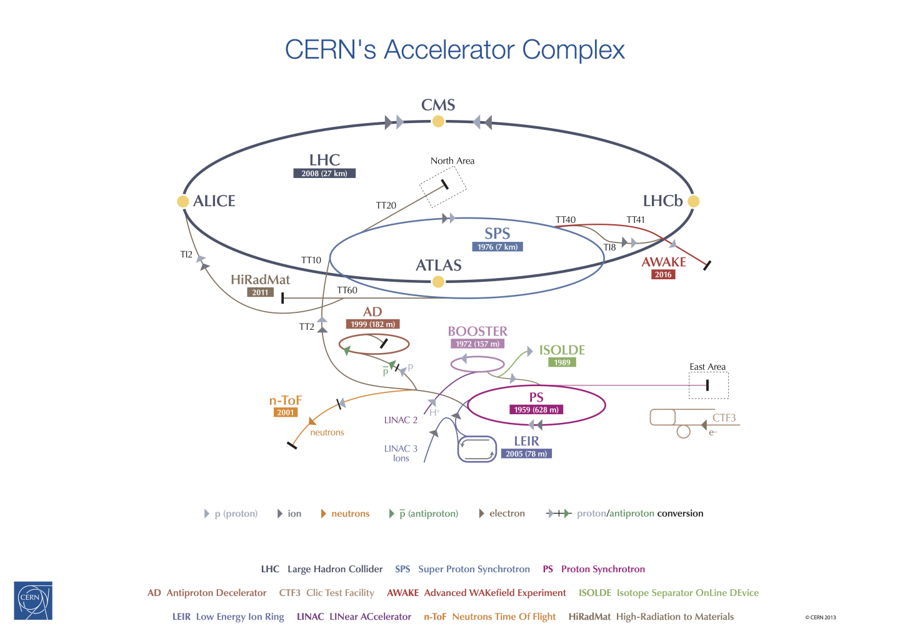

Slide 69
Proposed strategy for LHC start up in 2015: Summary
450GeV
6.5 – 7 TeV
Commissioning (low intensity / luminosity)
Vacuum conditioning (50ns/short trains 25ns)
(5-7 days)
50ns
(intensity ramp up + physics)
Scrubbing with 25ns
(2 days)
δ_{dip}≥2.2
δ_{dip}≈2.2
δ_{dip}≤2.
450GeV
6.5 – 7 TeV
25ns scrubbing
(5 days)
25ns test ramps + commissioning (≈ 5 days)
Scrubbing with doublet beams
(≈ 5 days)
δ_{dip}≤2.
δ_{dip}≈1.45
δ_{dip}≤1.4
Intensity ramp up & physics with 25ns

